Slide 1
Assertions About NBA Players
Group 3
Bryce Rutt
Ashwini Senthilnathan
Md. Shamsul Alam Khan
Getrude Shabiha

Slide 2
TABLE OF CONTENTS
01
Overview
05
Regression Analysis
02
06
2 Population T-Test
Logistic Regression
03
07
Chi-Squared
Conclusion
04
ANOVA

Slide 3
01
Overview

Slide 4
Overview
Why
What
How
Many fans and sports analysts use various stats about NBA players to either diminish or prop up various players. This study will test if some of those assertions have any merit.
Various debates and assertions made by the media and fan of NBA players.
2 population t-test
Chi Squared
ANOVA
Regression Analysis
P-Value Decision with Confidence Level of 95%.

Slide 5
Assertions About NBA Players
A
Do players give more effort during the postseason than the regular season?
D
Are individual player statistics significant in determining their salary?
Are certain positions more common to play than others?
Are stereotypes about height, quality of opponents, and playing time affecting scoring efficiency true?
B
E
C
Does scoring efficiency vary based on position?
F
Does a player’s height and average playing time affect their probability of becoming a full-time starter?

Slide 6
02
2 Population T-Test

Slide 7
Is Regular season scoring different from Postseason Scoring?
Populations:
Regular Season Average Points Scored
Postseason Average Points Scored
H0: µ_{regular} = µ_{post}
HA: µ_{regular} ≠ µ_{post}
Assumptions:
Normal Distribution of Data
Unequal Variances due to difference in Sample Size

Slide 8
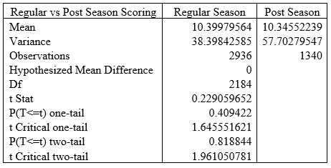
Results and Analysis
P-value = 0.818844 > 0.05
Fail to Reject Null Hypothesis
Cannot conclude that the average points scored by the NBA in the regular season differs from the average points scored by NBA players in the postseason.
Expel the notion that NBA players do not try as hard in the regular season as postseason

Slide 9
03
Chi-Squared
Goodness of Fit

Slide 10
Do the percentage of players differ by position?
Chi-square tests are conducted to detect if there is a difference in the expected population proportions based on a categorical variable.
It will be employed to test if there is a significant difference in the percentage of players at each position.
Categorical Variable: NBA Player Positions with Abbreviations
Center (C) Small Forward (SF) Power Forward (PF) Shooting Guard (SG) Point Guard (PG)
H0: p_{C} = p_{SF} = p_{PF} = p_{SG} = p_{PG}
HA: At least one population proportion is not equal to the rest.
Assumption: Categorical variables are mutually exclusive.

Slide 11
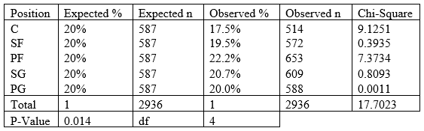
Results and Analysis
Chi-square statistic = 17.7023
P-value = 0.014 < 0.05
Reject Null Hypothesis
Can be concluded that some positions are more common than others.
Helps prove the assertion that some positions are more common to play.

Slide 12
04
ANOVA

Slide 13
Does scoring efficiency vary based on position?
One common assertion is that certain players are only efficient scorers because of the position they play. Is this a fair statement to make?
Assumptions:
Normal Distribution of Data
Equal Variances between Populations
Independence of Samples
H0: µ_{C} = µ_{SF} = µ_{PF} = µ_{SG} = µ_{PG}
HA: At least one sample mean does not equal the rest.

Slide 14
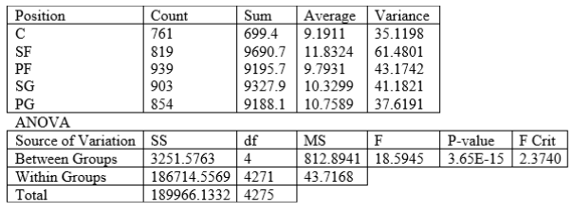
Results and Analysis
ANOVA test shows p-value close to 0.
Null hypothesis is rejected.
Can conclude there is a significant difference between the average points scored by different NBA player positions.
This study helps give credence to fans and analysts who claim that certain players or positions are more valuable to a team than others.

Slide 15
05
Regression
Analysis

Slide 16
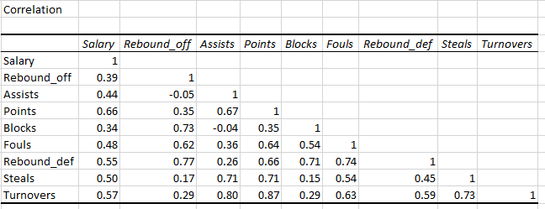
Are player stats significant in determining career salary?
Regression Equation:
Salary = Intercept + B1 * Rebound_off + B2 * Points + B3 * Assists + B4 * Blocks + B5 * Steals + B6 * Rebound_def + B7 * Fouls + B8 * Turnovers + E
H0: B1 = B2 = B3 = B4 = B5 = B6 = B7 = B8 = 0
HA: At least one variable is significant in predicting player salary.
Assumptions:
Linearity
Independence of Error
Normality of Error
Equal Variances

Slide 17
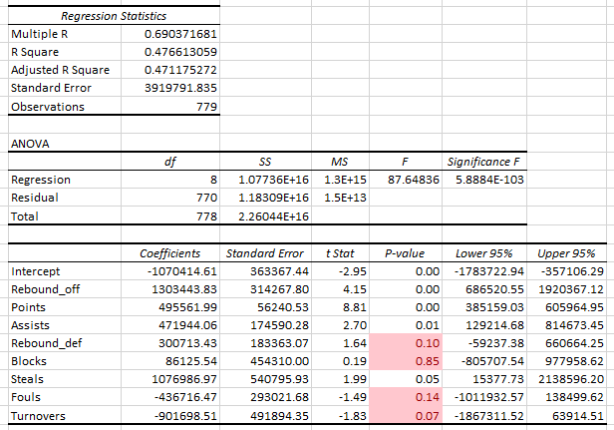
Regression Output
Adjusted R-Square = 0.47117
Standard Error = 3919791.835
P-Value < 0.05 for significance
Insignificant Variables:
Rebound_Def
Blocks
Steals
Fouls
Turnovers

Slide 18
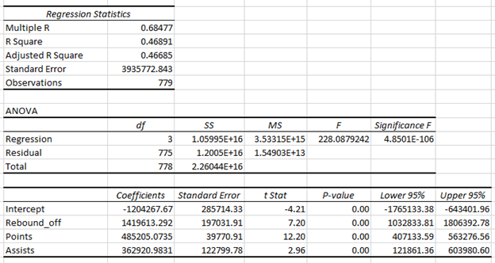
Best Fit Model and Predicted Salary
Predicted Salary = -1204267.67 + 1419613.29 * Rebound_off + 485205.07 * Points + 362920.98 * Assists
Prediction using Lebron James’ Career Stats:
Rebound_off = 1.35
Points = 27.6
Assists = 6.8
Predicted Career Salary = $16,571,733
Actual Career Salary = $22,970,500
Why is there such a large discrepancy?

Slide 19
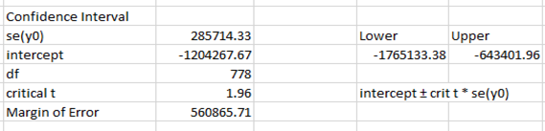
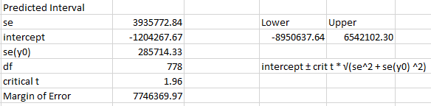
Confidence and Prediction Intervals
Confidence Interval cannot be applied in a practical scenario because salary cannot be negative.
[ -1,765,133.38, -643,401.96]
95% of new players will have a career salary between 0 and $6,542,102.30.
[ -8,950,637.64, 6,542,102.30]

Slide 20
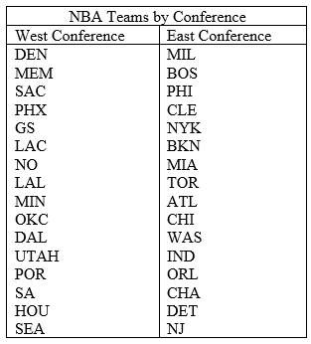
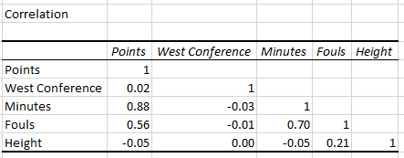
Are stereotypes about height, quality of opponents, and playing time affecting scoring efficiency true?
Regression Equation: Points = Intercept + B1 * West_Conference + B2 * Minutes + B3 * Fouls + B4 * Height + E
H0: B1 = B2 = B3 = B4 = 0 HA: At least one variable is significant
Assumptions:
Linearity
Independence of Error
Normality of Error
Equal Variances

Slide 21
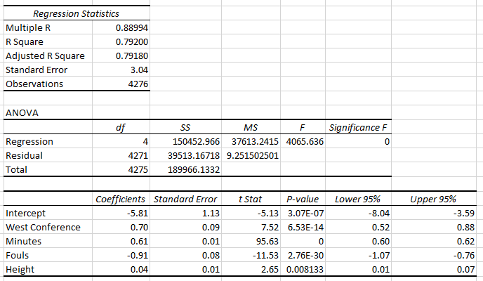
Regression Output
Adjusted R-Square = 0.7918
Standard Error = 3.04
P-Value < 0.05 for significance
All variable are significant.
Consider removing variables Height and West Conference due to low correlation despite statistical significance.

Slide 22
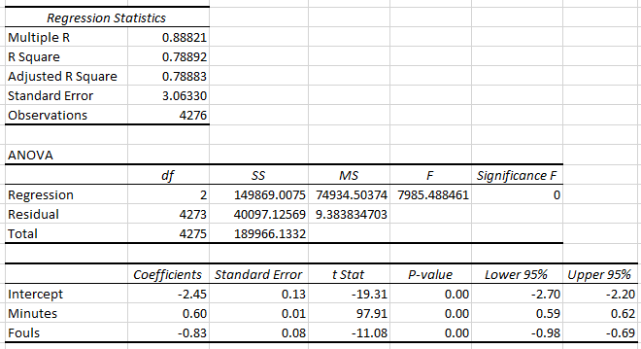
Best Fit Regression Model and Predicted Points
Removal of the variables West Conference and Height gives the following results:
Adjusted R-Square and Standard Error do not change much.
Prediction Equation:
Predicted Points = -2.45 + 0.6 * Minutes - 0.83 * Fouls
Use Kobe Bryant’s 2005 season stats to predict what he was expected to average.
Minutes = 41.0 Fouls = 2.9
Predicted Points = 19.9
Actual Points = 35.4
Why is there a large difference?

Slide 23
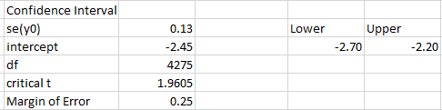
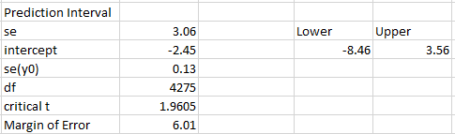
Confidence and Prediction Intervals
Confidence interval cannot be applied practically because a player cannot score negative points.
[-2.70, -2.20]
95% of new players added to the data will have and average points between -8.46 and 3.56. Since negative points is impossible, it is actually between 0 and 3.56.

Slide 24
06
Logistic Regression

Slide 25
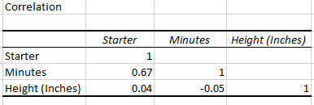
Does a player’s height and average playing time affect their probability of becoming a full-time starter?
Logistic Regression Equation:
P (Starter) = e ^ (B0 + B1 * Minutes + B2 * Height) / 1 + e ^ (B0 + B1 * Minutes + B2 * Height)
H0: B1 = B2 = 0
HA: At least one variable is significant
Reposnse Variable: Starter
1 = Starter
0 = Not Starter / Backup
Assumptions:
Linearity
Independence of Error
Normality of Error
Equal Variances

Slide 26
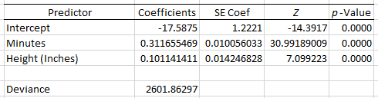
Regression Results and Predicted Odds Ratio
Both variables are significant.
Deviance = 2601.86
Predicted Odds Ratio: p (starter) = e^ (-17.5875 + 0.3117 * Minutes + 0.1011 * Height) / (1 + e ^ (-17.5875 + 0.3117 * Minutes + 0.1011 * Height))
Use the average minutes and height of data set to calculate probability of the average NBA player becoming a full-time starter.
Average Minutes = 24.12 Average Height = 79.10
p (starter) = -2.07 / -1.07
p (starter) = 0.112 or 11.2%

Slide 27
07
Conclusion

Slide 28
Are these assertions about NBA players valid?
A: Do players give more effort during the postseason than the regular season?
No, the average points scored between the regular season and the postseason are not significantly different.
B: Are certain positions more common to play than others?
Yes, some positions are more common to play than others. This leads to the possibility of one position being more important to the team as they are harder to replace.

Slide 29
Are these assertions about NBA players valid?
C: Does scoring efficiency vary based on position?
Yes, scoring efficiency is affected by the position a player normally plays to a degree.
D: Are individual player statistics significant in determining their salary?
Only some statistics, which are Offensive Rebounds, Points, and Assists. Many outside factors influence player salaries.

Slide 30
Are these assertions about NBA players valid?
E: Are stereotypes about height, quality of opponents, and playing time affecting scoring efficiency true?
No, height and quality of opponent were found to have little correlation to scoring efficiency despite being statistically significant.
F: Does a player’s height and average playing time affect their probability of becoming a full-time starter?
It is statistically significant, but there are other factors outside the data set, but average playing does play a role, but it does disprove stereotypes about height.

